Slide 1
Accident Prevention and Fire safety Unit- III
Accident – Classification, cost, causes, prevention, techniques

Slide 2
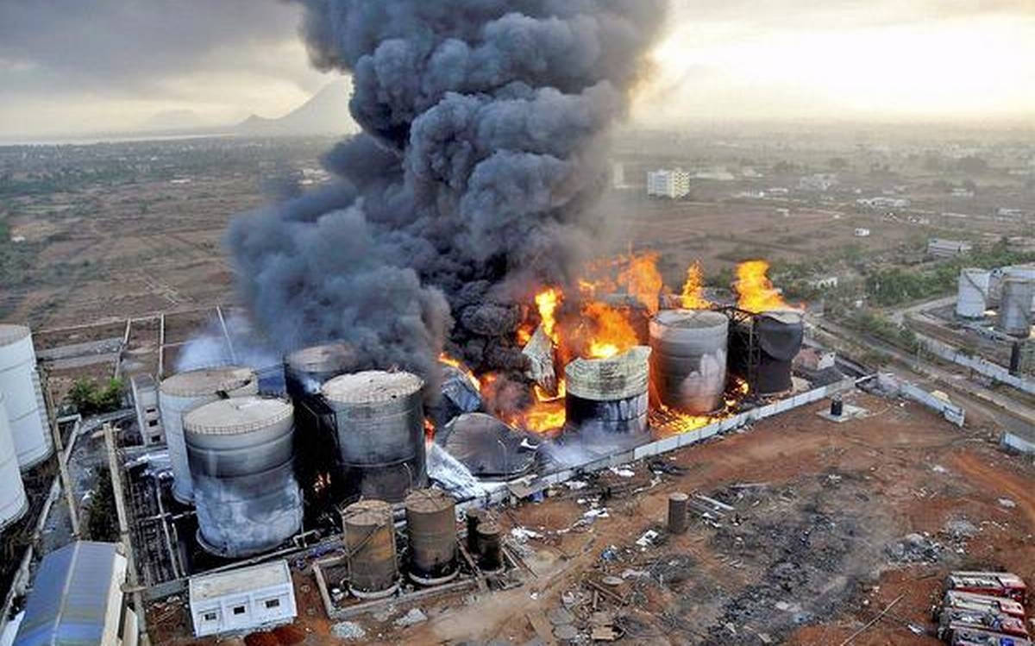
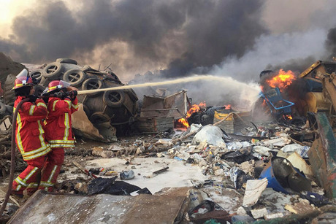
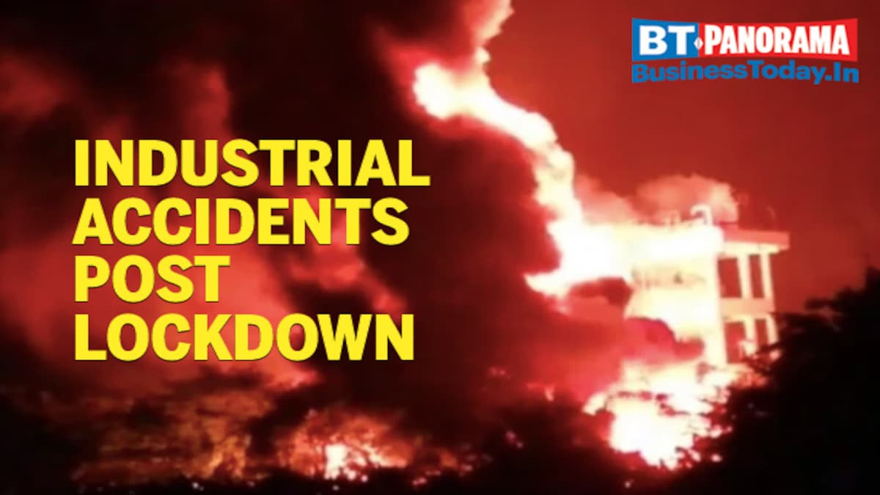
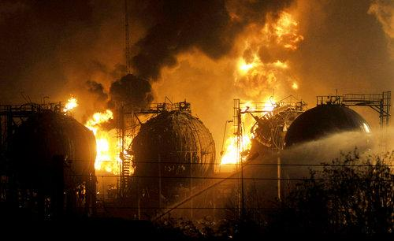
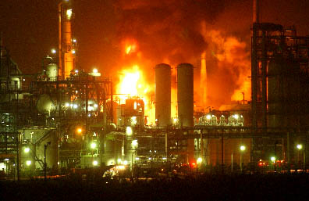
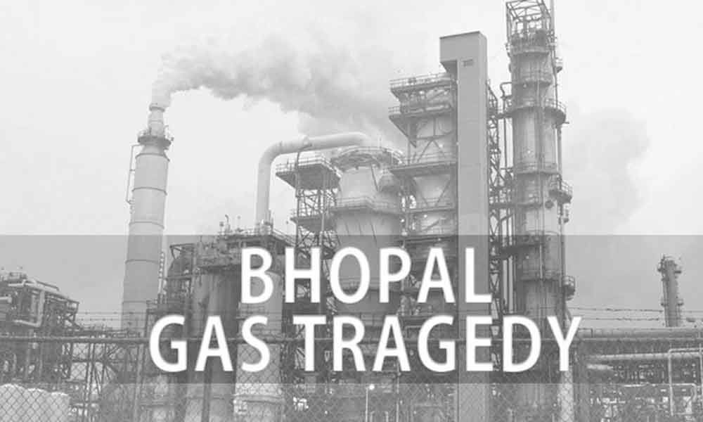
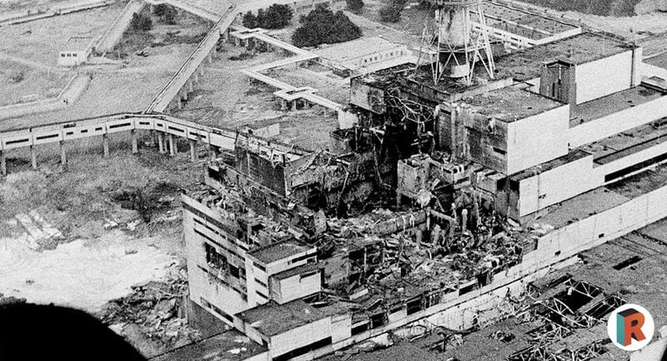
Industrial accidents
Iran
China
Chernobyl

Slide 3
Classification of accidents
There are many methods of classifying industrial accidents:
Some classify accidents according to where the fault lies
Some classify according to the cause (Based on international conference of labour statisticans, by ILO in 1923)
Machinery
Transport equipment
Explosions and fire
Poisonous
hot or corrosive substances
falling objects
handling without machinery
Hand tools
animals,etc

Slide 4
In october 1962
Industrial accidents are classified under:
The type of the accident
The agency (related to injury/related to accident)
The nature of the injury
the bodily location of the injury

Slide 5
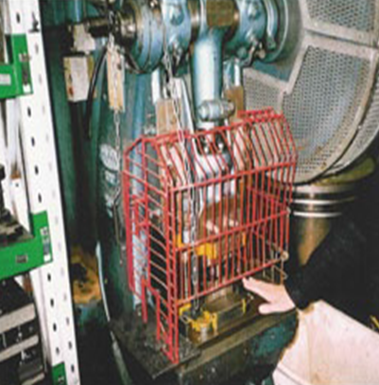

Unsafe physical conditions may be grouped :
Inadequate mechanical guarding
Defective condition of equipment
Unsafe design or construction
Hazardous process
Improper illumination
Incorrect ventilation
Unsafe dress

Slide 6
Unsafe personal acts – that leads o injuries
Improper lifting, hazardous placement, incorrect mixing
Without supervision operating the machines
Removing safety devices
Operating at unsafe speed
Unsafe and improper equipment
Without PPE

Slide 7
Analyzing the causes of accidents – 10 steps
Secure supervisor’s report of accident
Secure the injured worker’s report
Secure the reports of witnesses
Secure the report of nurse/doctor
Investigate the accident
Record all the facts
Tabulate the facts of accident with other
Study all the facts
Determine what act should be taken
Assign responsibilities

Slide 8
Costs of accidents
H.W.Henrich listed 11 elements.
Cost of loss time of injured employee
Cost of time lost by other employees who stop work
Cost of time lost by foremen, supervisor
Cost of time spent on the case of first aid attendant, hospital staff, where not paid
Cost due to damage of machines, etc
Incidental costs due to interference with production
Cost of employer under employee welfare
Cost of employer in continuing the wages of injured worker in full
Cost due to loss of profit
Cost of subsequent injuries that occur in consequence
Overhead cost per injured worker

Slide 9
Basic Principles of accident prevention
The core of accident prevention principle consists of foreseeing the unsafe conditions and of rectifying them before accident occurs.
Investigation of an accident, even if it has not resulted in injury, aids in pinpointing the deficiencies in the set-up and helps in preventing recurrence of accidents
How we do progress?
What is the effect of industrialization?
What shall we do then?
What was done for reducing the hazard?

Slide 10
Typical accident prevention activities
Safety inspections
Hazard surveys
Accident investigations
Safety device checks
Safety training

Slide 11
Techniques of accident prevention
Objective : control hazards at work, so as to reduce or eliminate accidents
3 steps in management of hazards:
Identification
Evaluation or assessment
Control
Within the organization, several ways by which hazards may be identified:
1. workplace inspections
2. management/worker discussions
3. independent audits
4. job safety analysis
5. hazard and operability studies

